Slide 1
Introducing Assignment: Earth
Faculty Senate
October 19, 2022

Slide 2
Assignment: earth
Umbrella framework that embraces the full breadth and scope of USC sustainability efforts
Developed by 100+ faculty, students, and staff across USC through the President’s Working Group on Sustainability
Key presidential priority that is core to our academic and administrative operations going forward

Slide 3
Why everyone is needed
At USC, sustainability is understood through the lens of deep disciplinary expertise and broad, inter-disciplinary, inclusionary problem-solving
Guiding Principle: climate change and sustainability affect all aspects of human life and natural systems, and as a result, every discipline contributes to this education and research effort

Slide 4
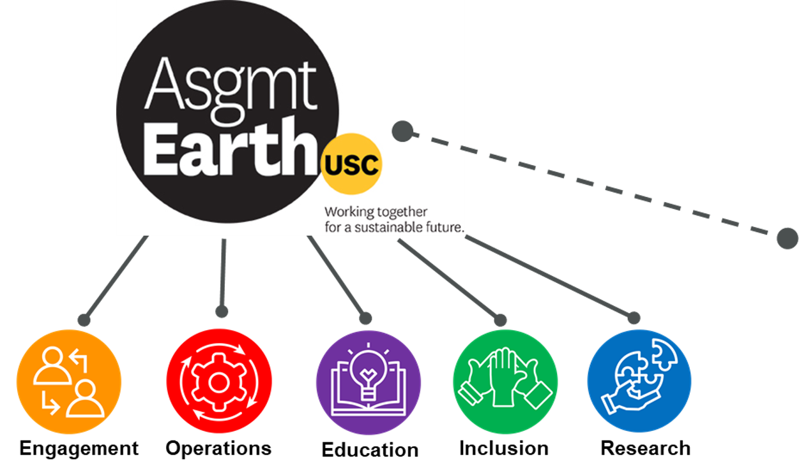
Assignment: earth
Each of the pillars of A:E has a home in every school across campus
Notes:
Explanation of how the constellation of sustainability aligns under the Assignment: Earth umbrella

Slide 5
Assignment: earth key goals
Double sustainability research by 2028
Increase sustainability courses by 10 each year, as well as add new majors, minors, and certificates
Climate neutrality by 2025
Zero waste by 2028
20% water reduction by 2028
See all goals at: Sustainability.usc.edu

Slide 6
Assignment: earth and you
Your partnership and support are critical to reaching A:E goals
Participating in the Sustainability Across the Curriculum (SACI) program and encouraging other faculty to take advantage of SACI grants*
Developing new interdisciplinary sustainability minors, majors, certificates, seminars, micro-seminars, guest lectures
Supporting hiring of faculty with sustainability knowledge
Developing interdisciplinary sustainability research proposals
Participating as a faculty mentor of Sustainability Postdoc Fellows
Encouraging and adopting use of support tools such as the Sustainability Data Hub, UN SDG course search tool, Open Access Research Initiative, student sustainability online training, sustainability faculty directory
* SACI info located at https://dornsife-wrigley.usc.edu/education/sustainability-across-the-curriculum-initiative/
Notes:
Grants to create new classes, minors, or majors, or infuse sustainability into existing courses
Faculty from ALL schools, and both undergrad and grad are eligible
Faculty from Annenberg, Architecture, Dornsife, Keck, Marshall, Rossier, and Viterbi received grants last year

Slide 7
Assignment: earth recent achievements
17,000 students enrolled in sustainability courses
Sustainability Solutions Post-doctoral Fellowship program launching
Sustainability seed grants through Office of Research
25MW solar agreement with LADWP
Provides 25% of USC electricity
Reduces USC emissions by about 20%
Will make renewable energy sources more accessible and affordable for residents and businesses surrounding USC’s campuses
Single-use plastic bottle elimination
AASHE STARS Silver rating
Sustainable Design and Construction Guidelines
Athletics three-time champions of PAC-12 Zero Waste Challenge
Country’s first campus “green zone” – certified by American Zone Alliance

Slide 8
Thank you!
Sustainability.usc.edu

Slide 9
Backup
Sustainability.usc.edu

Slide 10
Research Focus
With the goal of doubling university’s research volume by 2028, we envision::
Coalescing multidisciplinary teams around high-impact themes, such as:
Human health and well-being
Infrastructure and the built environment
Natural environment and ecosystem services
Communications, policy, and institutions
Risk analysis and economic impacts
Developing enabling processes and programs, such as:
Post-doctoral and graduate fellowships
Seed-funding for team-based research and innovation projects
Faculty hiring to address gaps and emphasize strengths

