Slide 1
Faculty rights & Responsibilities (FR&R) End of Year Summary
Academic Senate Meeting
Ashley Uyeshiro Simon & Devon Brooks (Co-Chairs)
May 11, 2022

Slide 2
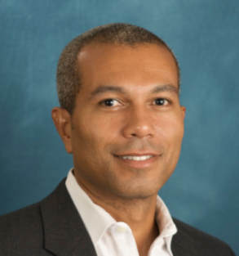
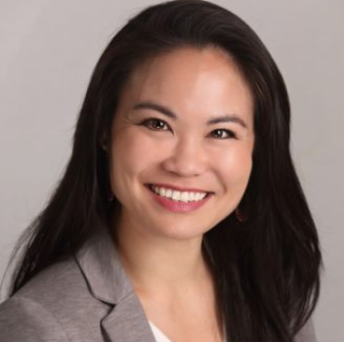
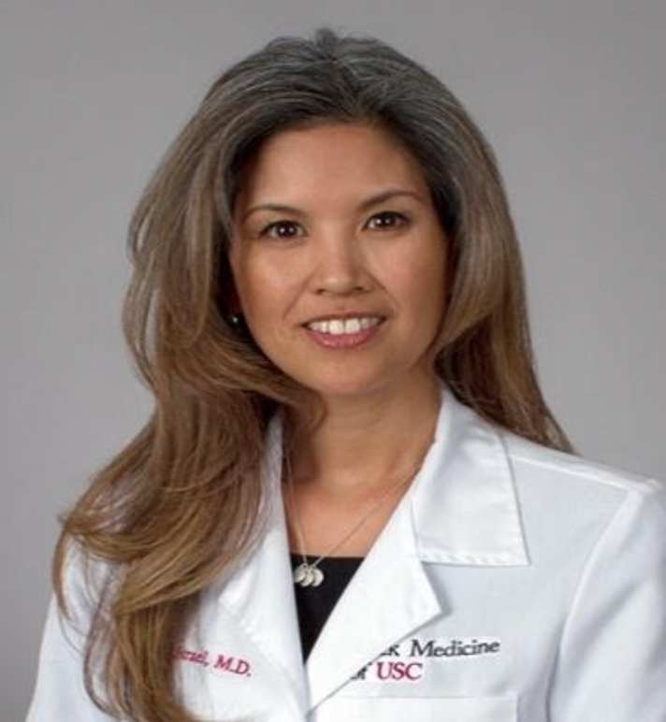
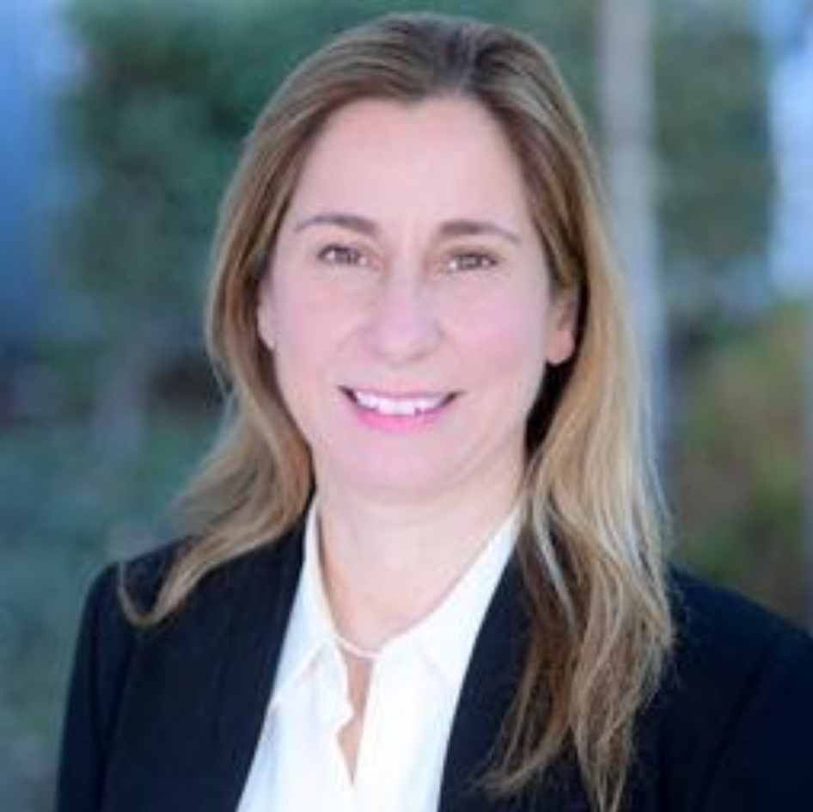
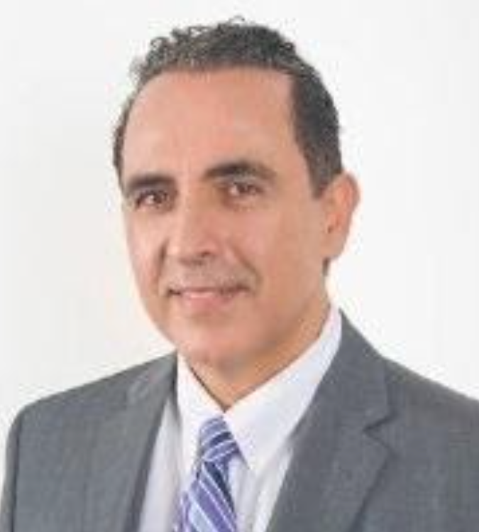
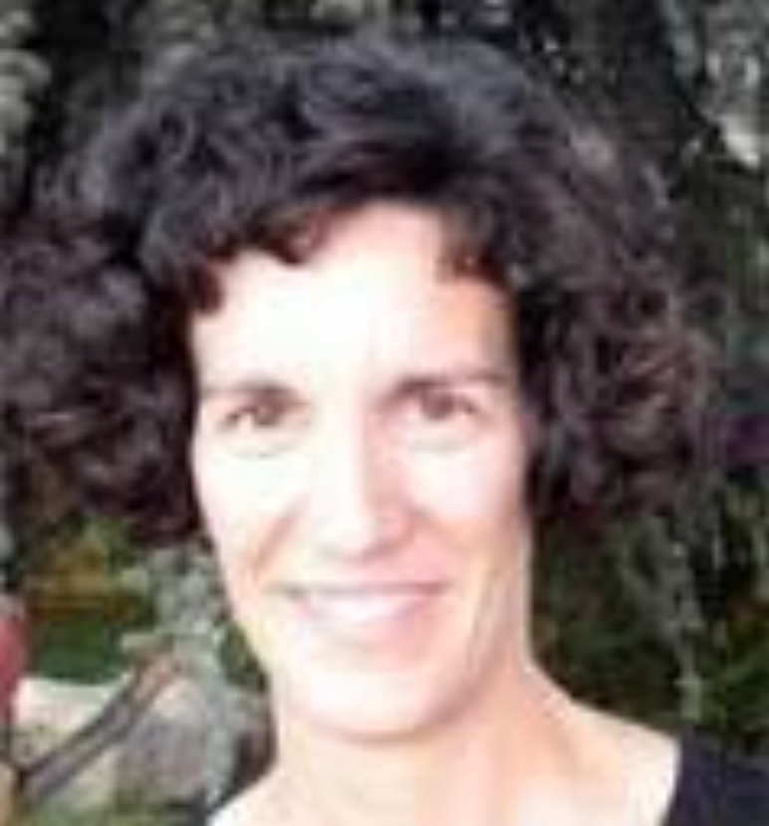
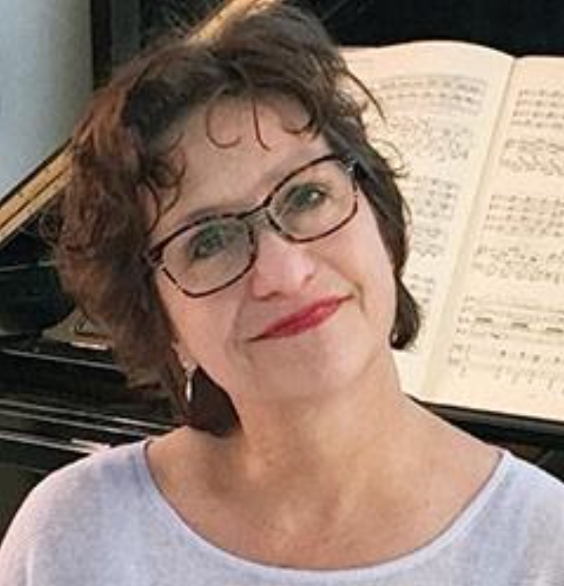
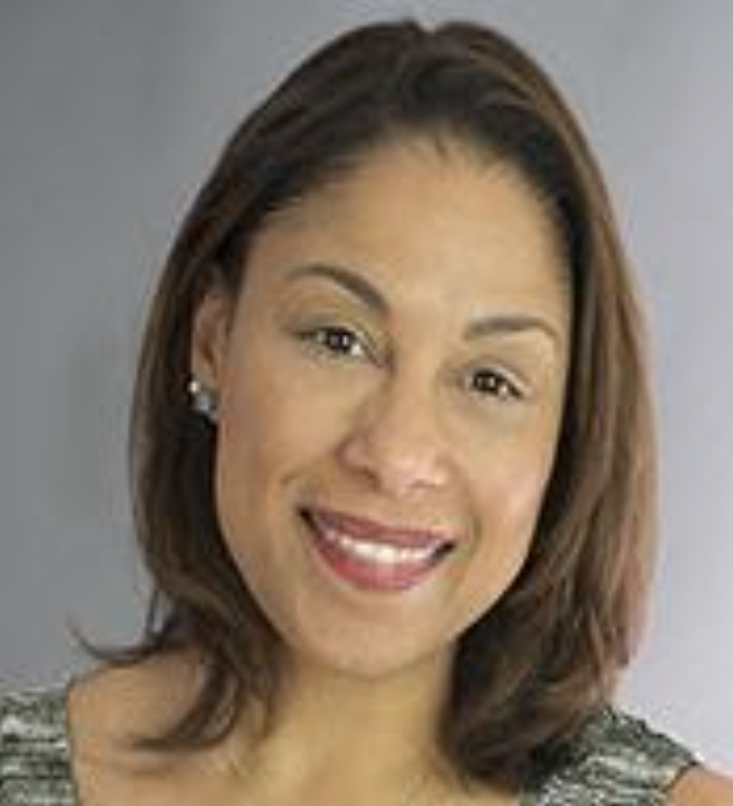
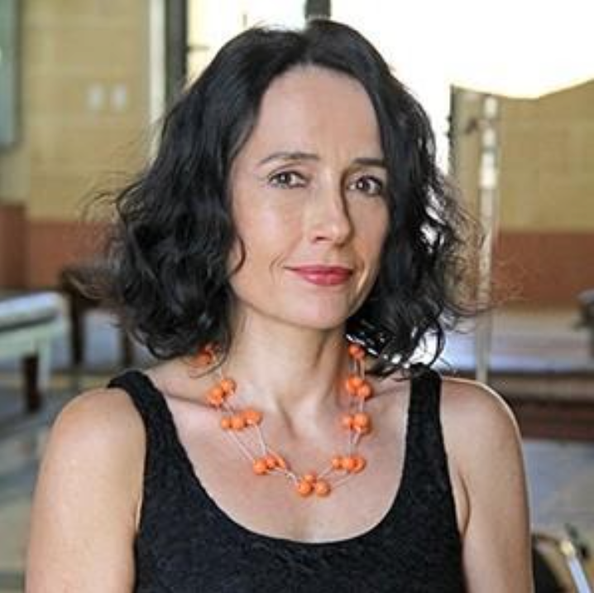
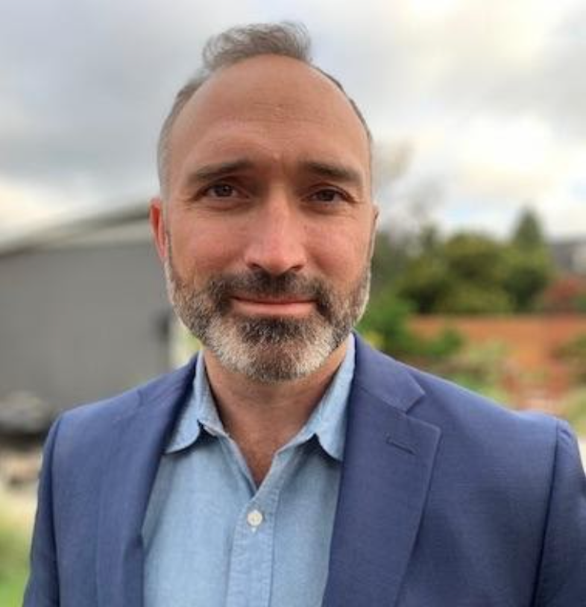
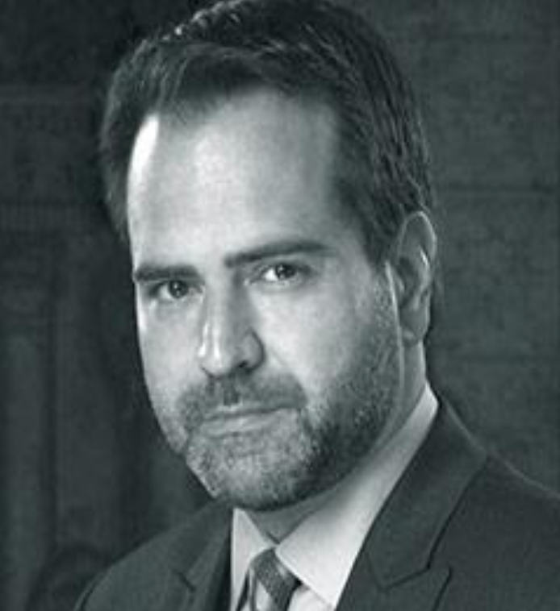
FACULTY RIGHTS AND RESPONSIBILITIES COMMITTEE (FR&R)
https://academicsenate.usc.edu/committees/faculty-rights/
Devon Brooks (Co-Chair)
Suzanne Dworak-Peck
School of Social Work
Ashley Uyeshiro Simon (Co-Chair)
USC Chan Division of Occupational Science and Occupational Therapy
Jennifer J. Israel
Keck School/Obstetrics and Gynecology
Rima Jubran
Keck School/CHLA
Shahed Rowshan
Viterbi School
Kimberly Siegmund
Keck School/Population and Public Health Sciences
Lucinda Carver
Thornton School of Music
Ange-Marie Hancock Alfaro
Dornsife College/International Relations
Aniko Imre
Cinematic Arts
Devin Griffiths
Dornsife College
Nick Stoubis
Thornton School of Music

Slide 3
Faculty contemplating filing grievances under Chapter 7 of the Faculty Handbook can receive help defining issues and identifying the remedy desired.
Grievances can be brought for any violation of rights provided by the Handbook, other policies, the law, or the individual’s faculty contract.
Initiated by completing form:
https://academicsenate.usc.edu/committees/faculty-rights/
May also begin by contacting a member of the committee
Faculty Rights & Responsibilities (FR&R)

Slide 4
Types of Support Provided
Help on disputes or other problems with colleagues (as distinguished from formal grievances).
Committee serves as a panel on collegial problem-solving offering consultation and informal mediation to try to resolve such problems.
Consultation is meant to be confidential.
NO legal advice is given!

Slide 5
Activities Carried Out This Year
Faculty Consultation
About 7 consultations (lower than last year)
Issues included procedural complaints, job security and promotion questions, among others
Meeting with Keck Faculty Council
Committee Capacity-Building and Development
Committee structure and approach (e.g., panel approach)
Training Manual / Guidebook

Slide 6
Issues Encountered This Year
Committee transition
Roles and responsibilities
In relation to other offices, people and functions
For example: Ombuds Office, Faculty Handbook, mediation
Understanding procedures and policies
“On pause”

Slide 7
Recommended Priorities for Next Year
Training Manuel / Guidebook
Case tracking and reporting
Case meetings
Outreach
Meetings with Faculty Councils

Slide 8
Issues for Further Consideration
Data and trends
Faculty advocacy vs. mediation
Peer support model / Scope
Support to both the alleged victim and perpetrator
Support to faculty we don’t hear about beyond FRR grievance process
Prevention and targeted strategies
Assessment of needs

