Slide 1
Embracing Inclusion in Faculty Hiring & Retention
Lori Nishiura Mackenzie
Executive Director, Clayman Institute for Gender Research
Co-founder, Stanford VMware Women’s Leadership Innovation Lab Executive

Slide 2
Framework
“Small Wins” Approach to Change

Slide 3
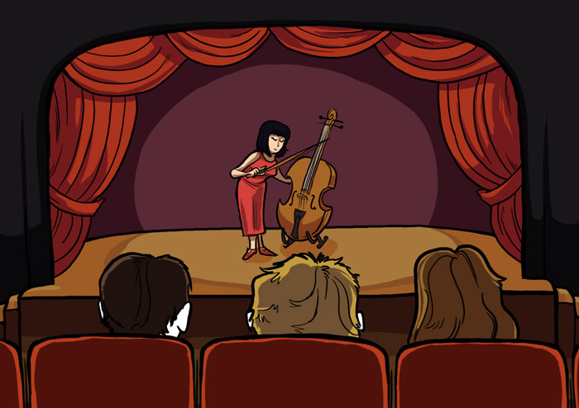
(Goldin & Rouse 2000)

Slide 4
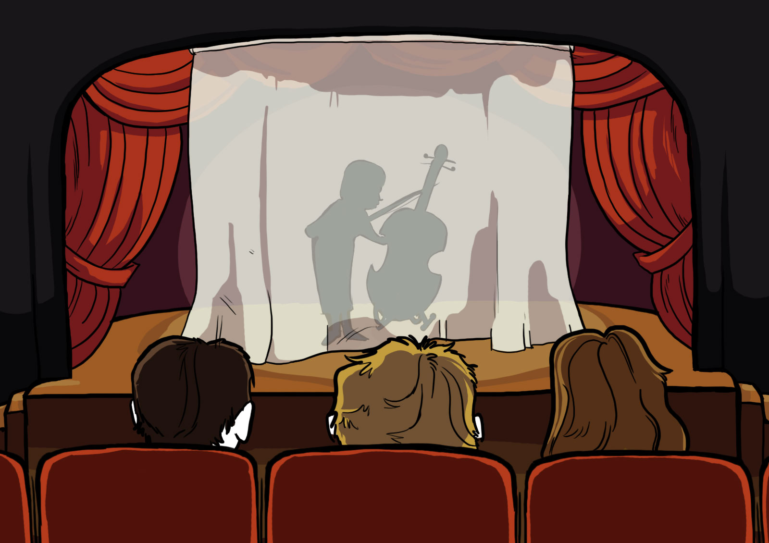
(Goldin & Rouse 2000)

Slide 6
Barriers
To Fair and Inclusive Assessments

Slide 7
Bias is an error in assessing talent.

Slide 8
Stereotypes function as cognitive shortcuts in information processing.

Slide 9
Biases are more likely when…
We are overwhelmed with information
In a hurry to make decisions
The criteria for making evaluations are unclear
We do not have a consistent process to guide group decision-making
(Correll 2017)

Slide 10
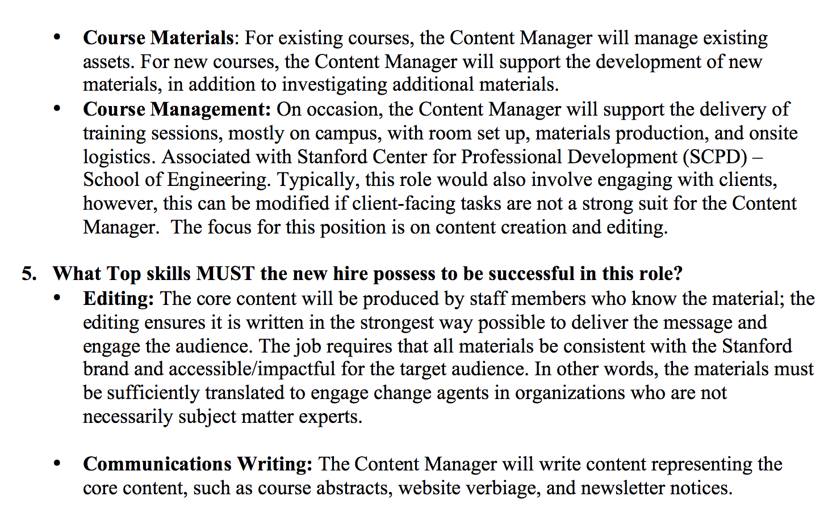
Same legal brief, different races
Thomas Meyer
Seniority: 3rd Year Law Associate
Alma Mater: NYU
Race/Ethnicity: White
Thomas Meyer
Seniority: 3rd Year Law Associate
Alma Mater: NYU
Race/Ethnicity: African American
(Reeves 2014)

Slide 11
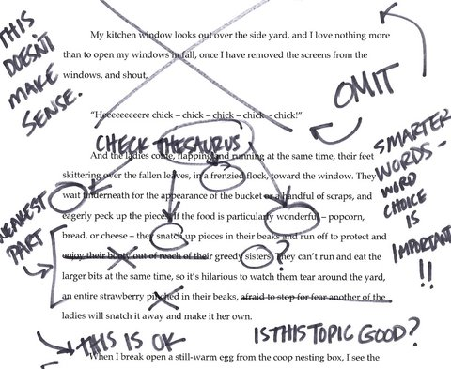
Same legal brief, different races
Thomas Meyer
Seniority: 3rd Year Law Associate
Alma Mater: NYU
Race/Ethnicity: White
Thomas Meyer
Seniority: 3rd Year Law Associate
Alma Mater: NYU
Race/Ethnicity: African American
3x more edits/comments
2x more likely to find mistakes
(Reeves 2014)

Slide 12
Same legal brief, different races
Thomas Meyer
Seniority: 3rd Year Law Associate
Alma Mater: NYU
Race/Ethnicity: White
Thomas Meyer
Seniority: 3rd Year Law Associate
Alma Mater: NYU
Race/Ethnicity: African American
Score: 4.1 out of 5
“generally good writer but needs to work on…”
“has potential”
“good analytical skills”
Score: 3.2 out of 5
“needs lots of work”
“can’t believe he went to NYU”
“average at best”
(Reeves 2014)

Slide 13
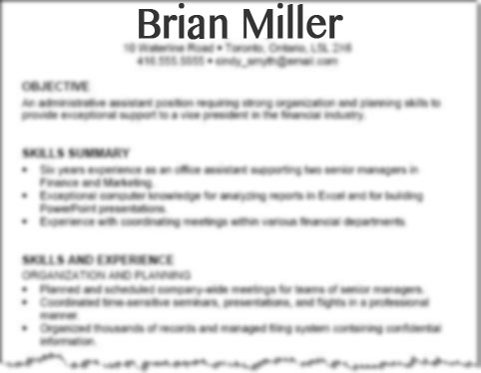
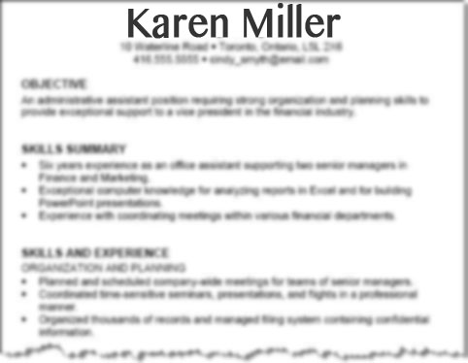
More education
More experience
✔
(Uhlmann & Cohen 2005)

Slide 14
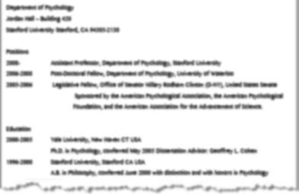
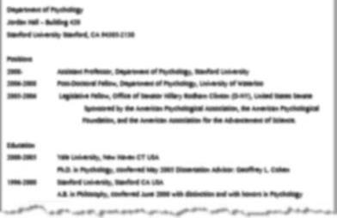
Same resume, different names
Brian Miller
Karen Miller
72%
44%
(Steinpreis, Anders & Ritzke 1999)

Slide 15
Extra scrutiny
“I would need to see evidence that she had gotten these grants and publications on her own.”
“It would be impossible to make such a judgment without teaching evaluations.”
(Steinpreis, Anders & Ritzke 1999)

Slide 16
More education
More experience
✔
(Uhlmann & Cohen 2005)

Slide 17
More education
More experience
✔
(Uhlmann & Cohen 2005)

Slide 18
More experience
More education
✔
(Uhlmann & Cohen 2005)

Slide 19
The most common way that we transmit and maintain culture is through language.

Slide 20
Benschmidt.org/profgender/

Slide 24
Less likeable
More Competent
✔
More Competent
(Rudman 1998)

Slide 25
Mechanisms Leading to Bias
Higher Bar: More evidence needed to be seen as equally competent.
Extra scrutiny. New criteria raised.
Shifting criteria. Justifying a “gut” decision.
Over-valuing agency and under-valuing communal.
Likability penalty. Undue communication criticism for women and people of color.

Slide 26
Tools for Change
Beyond Bias

Slide 27
Creating a Diverse Applicant Pool
Describe positions broadly in job ads.
Avoid laundry list of requirements.
Beware of narrow searches.
Experiment with “try outs”.

Slide 28
Before Evaluating Applicants
Discuss and align on criteria before evaluating applicants.

Slide 29
Before Evaluating Applicants
✔
More experience
More education

Slide 30
Before Evaluating Applicants
Discuss and align on criteria before evaluating applicants.
What are our implicit templates of success?

Slide 31
Before Evaluating Applicants
Reexamine criteria
Are your criteria the right criteria?
Do your criteria contain gender or other biases?
Question criteria related to style or personality, which maybe unrelated to performance.
Move from “experiences” to skills/competencies.
Read papers/research statements before looking at CV.

Slide 32
Faculty Letters of Recommendations
Dept. | Men Applicants | Women Applicants
Psychology | Agentic language “Ambitious” | Communal language “Helpful”
Chemistry | Standout adjectives
Medicine | Longer Professional achievements | Shorter Doubt-raising statements
(Madera, Hebl, and Martin, 2009)
(Schmader, Whitehead, and Wysocki, 2007)
(Trix and Psenka, 2003)

Slide 33
Communal
Agentic
Warm Tactful Helpful Interpersonal Thoughtful Sensitive Caring | Confident Assertive Ambitious Outspoken Independent Dominant Forceful

Slide 34
Faculty Letters of Recommendations
Dept. | Men Applicants | Women Applicants
Psychology | Agentic language “Ambitious” | Communal language “Helpful”
Chemistry | Standout adjectives
Medicine | Longer Professional achievements | Shorter Doubt-raising statements
(Madera, Hebl, and Martin, 2009)
(Schmader, Whitehead, and Wysocki, 2007)
(Trix and Psenka, 2003)

Slide 35
Screening Applicants
Slow down. Develop a consistent approach for discussing candidates. Consider a rubric.
Encourage criteria monitoring to catch new criteria (e.g. “Is she moveable?”).
Be on alert for bias in recommendation letters, teaching evaluations and other indicators of performance and potential.

Slide 36
Interviewing Applicants
Develop a consistent interview process across candidates. Interview to criteria.
Be alert to whom is being interrupted in job talks. Consider appointing a facilitator.
Structure faculty discussions of candidates to get input from everyone.

Slide 37
Case Study
Chemical Engineering @ Stanford
Chaired by Assoc. Professor Tom Jaramillo 2016-17

Slide 38
Getting Beyond Bias in ChemE at Stanford
Created rubric for evaluating each applicant and interview questions for on-site interviews.

Slide 39
Rubrics
Clarify criteria
Consistent approach
Ensure same approach is applied to every candidate
(Stanford School of Engineering, 2016)

Slide 40
Getting Beyond Bias in Chemical Engineering at Stanford
Search chair collected faculty feedback, summarized and shared anonymously.
Faculty discussion started with one person who is supportive of the candidate
Offers were made to a woman and a man of color.

Slide 41
Endorsements

Slide 42
Endorsements
Bios
Letters of Recommendations
Introductions

Slide 43
https://womensleadership.stanford.edu
“Minimizing gender biases is modern workplaces:” A ‘small wins’ approach to organizational change.” (Correll 2017). Gender & Society.

