Slide 1
Supporting Students of Concern
Ilene Rosenstein, Ph.D.
Director, Student Counseling Services
Assistant Professor, CHLA College Health
Lynette Merriman, Ed.D.
Assistant Provost for Student Affairs
Support and Advocacy
Assistant Professor of Clinical Education, Rossier

Slide 2
Student Mental Health
Almost half of all college students will become seriously depressed or have a psychiatric illness during their college careers (Center for Collegiate Mental Health, 2016; Kadison & DiGeronimo, 2004; National Epidemiologic Survey on Alcohol and Related Conditions, 2006)
Suicide is second leading cause of death at four-year institutions (Center for Disease Control and Prevention, 2013; Turner, 2011)
Students are coming to college with more symptoms and more complex problems than previous student cohorts (Association of University and College Counseling Center Directors, 2015)
Nationally 19% undergraduates and 21% of graduate and professional students report receiving counseling services (Drum & Brownson, 2006)

Slide 3
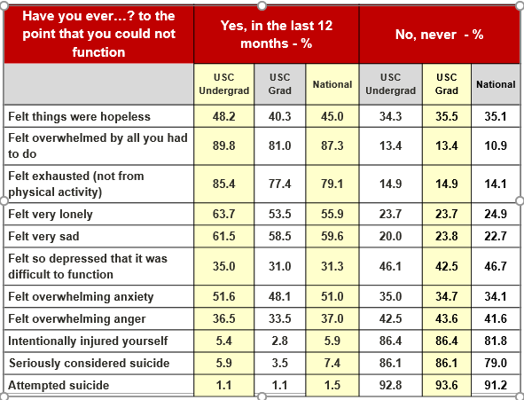
ACHA/NCHA USC Students

Slide 4
Helping Students
Guiding Principle: The more support the student has, the better the outcome
For non-threatening students, listen, persuade and refer
State in private your concern in behavioral, non-judgmental terms
Be clear what is the expected behavior
Listen, explore options and give hope
Ask “Who have you spoken to about this?” “Have you had this problem previously?” State that it often helps to speak with a professional and give the referral information

Slide 5
Warning Signs of Students in Crisis
Social withdrawal or isolation
Excessive feelings of rejection, betrayal, or persecution
Poor academic performance, motivation, or interest
Focus on violence or death
Uncontrolled or inappropriate anger
Patterns of impulsive, intimidating or bullying behavior
Drug and alcohol abuse
Serious threats of violence – especially if detailed and specific

Slide 6
Concern for Safety
If there is a question of safety
Life threatening/immediate threat: Phone DPS ASAP
EX: Physical aggression, destruction of property, verbal rage, and threats to use weapons
Non- threatening: Consult Student Counseling Services
EX: Psychosis, severe depression, suicidal ideation, and panic attacks

Slide 7
Contacting Student Counseling
Students may call the Student Counseling Services (SCS) at 213-740-7711
Give the SCS brochure or website
If students feel that they must see a counselor immediately, Student Counseling Services offers walk-ins between 8:30 am and 5:00 pm
If the faculty member feels the student must be seen immediately, call and consult with the on-call counselor who might recommend:
Student being walked over to SCS
SCS staff comes to the faculty to help
Workshop or training for department
A clinician is always available on-call 24/7

Slide 8
Campus Interventions
Team Approach
Student Affairs Student Concerns committee
Student Support and Advocacy (SSA)
USC Threat Assessment Team
Contact parents, outside mental health providers, and/or campus administrators
Wellness checks
Medical leaves of absences
Hospitalizations
SJACS or Title IX

Slide 9
https://studentaffairs.usc.edu/files/2015/09/Disruptive-and-Threatening-Behavior-Guide.pdf

Slide 10
Resources
Student Counseling Servicces (SCS) – 213.740.7711
Relationship and Sexual Violence Prevention and Services (RSVP) – 213.740.4900
Student Support and Advocacy (SSA) 213.821.4710

