Slide 1
Computing at USC: A Nascent Community
Paul S. Rosenbloom (Viterbi & ICT)
[with input from Tracy Fullerton (Cinematic Arts), Randy Hill (ICT & Viterbi), Daniella Meeker (Keck), Prem Natarajan (ISI/Viterbi), Cryrus Shahabi (Viterbi), Gaurav Sukhatme (Viterbi), Priya Vashishta (Viterbi & Dornsife)]
August 16, 2016

Slide 2
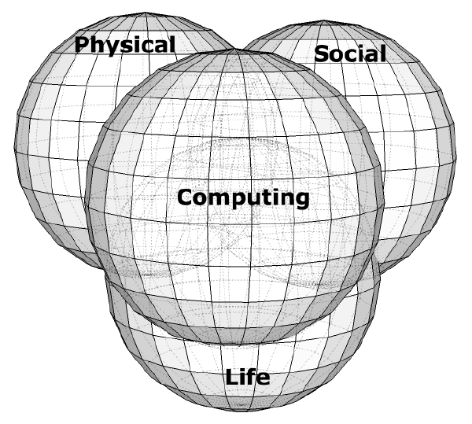
What is Computing?
Not just hardware or software or calculation or tools or theory
Transformation of information
By a wide variety of organic and inorganic systems
Core + multidisciplinary
Understanding + constructing
Many disciplines
Computer science and engineering
Information science, technology and theory
Computational science and scientific computation
(X-)Informatics and data science/analytics
Digital arts and humanities
…

Slide 3
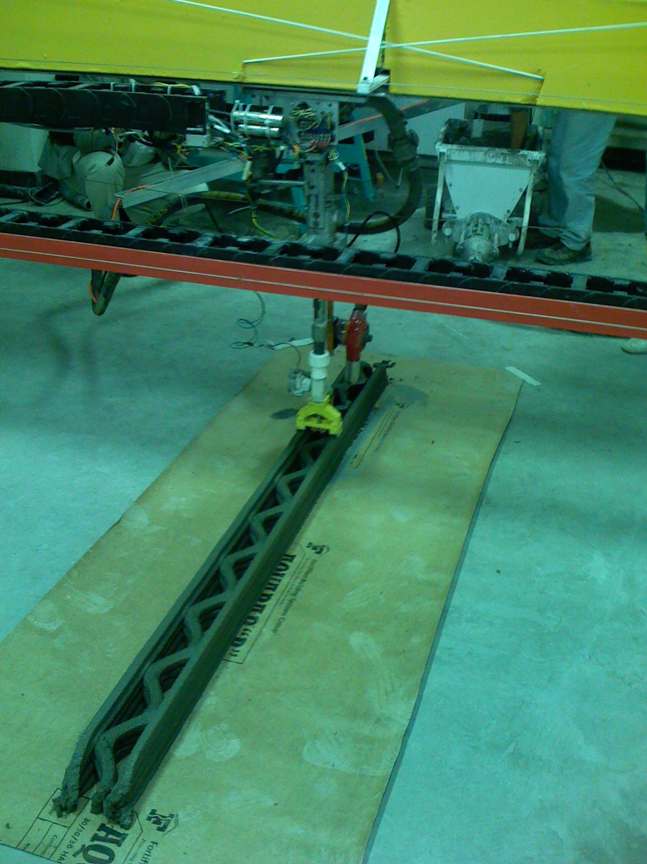
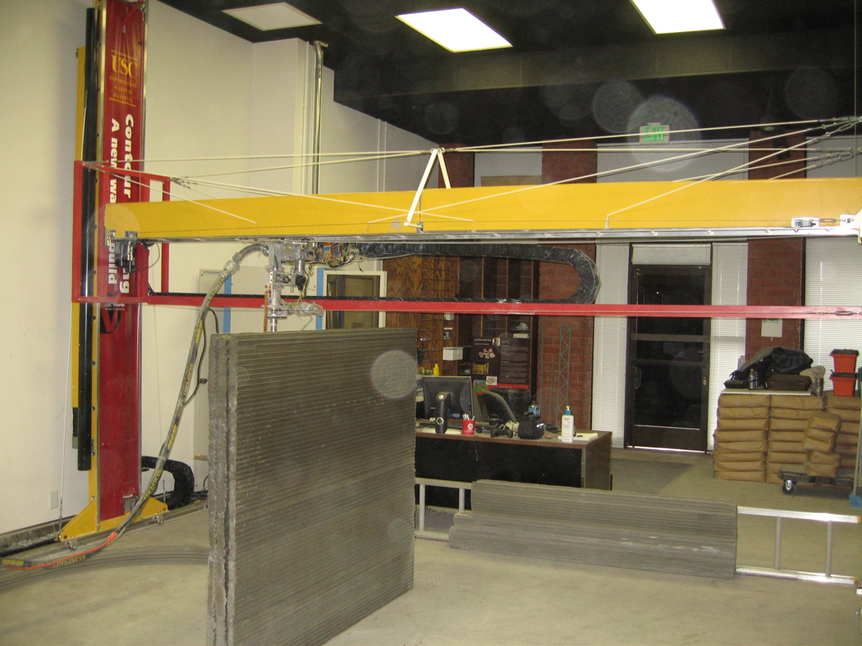
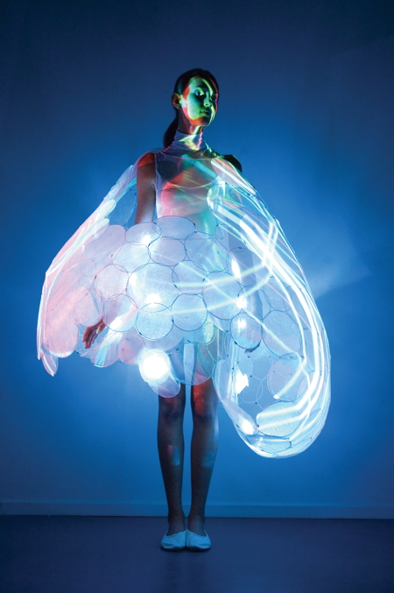
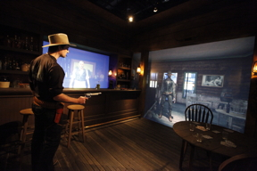
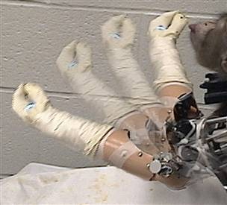
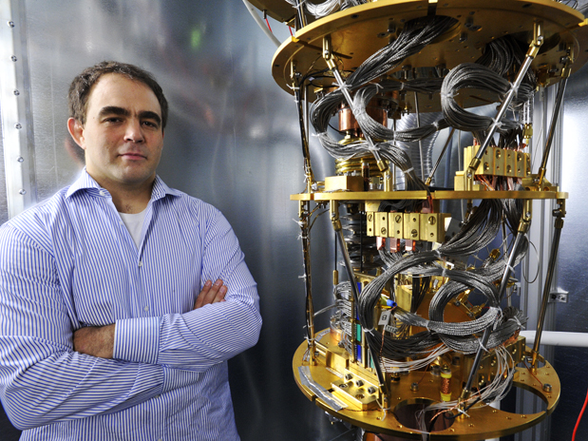
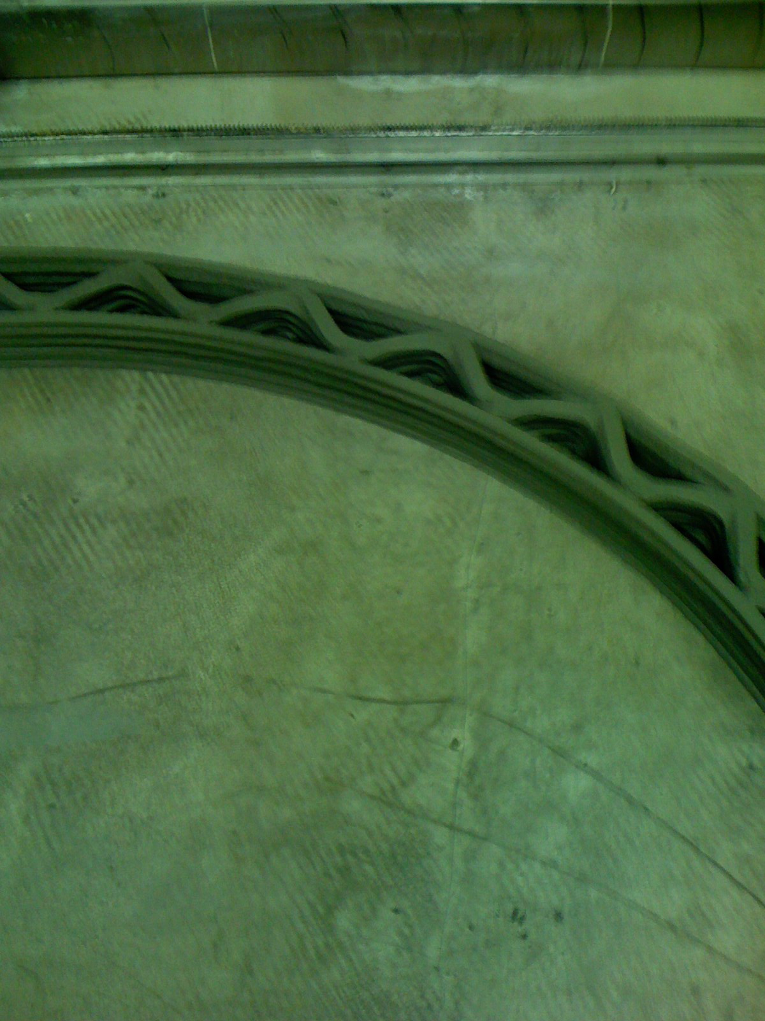
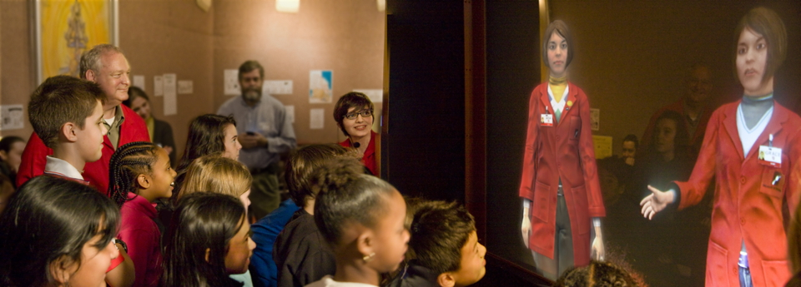
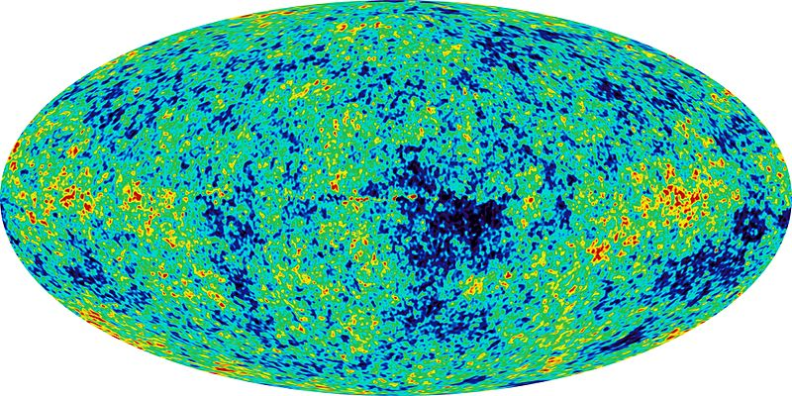
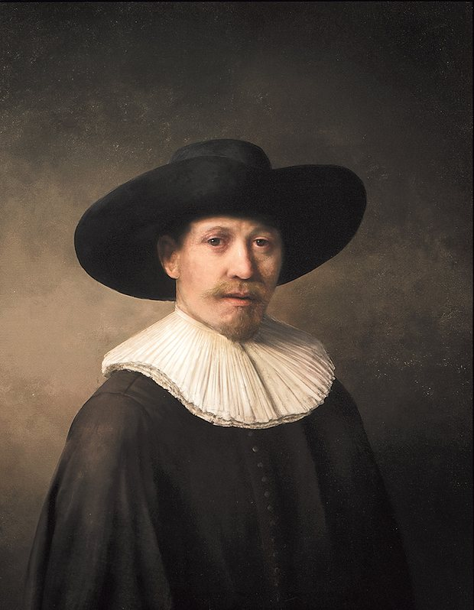
Computing Includes, For Example
Robots capable of constructing houses automatically
Clothing that senses and communicates emotions
A deep intermingling of real and virtual worlds
Quantum computers of heretofore inconceivable power
Monkeys controlling robotic arms by pure thought
Technology enabled superhuman intelligence
The potential computational basis of the universe
Computational arts
…
USC – Gunslinger
USC — Contour Crafting
D-Wave — Quantum Computer
Philips — SKIN
USC – Ada & Grace
University of Pittsburgh
The Next Rembrandt

Slide 4
Computing Includes, For Example
Robots capable of constructing houses automatically
Clothing that senses and communicates emotions
A deep intermingling of real and virtual worlds
Quantum computers of heretofore inconceivable power
Monkeys controlling robotic arms by pure thought
Technology enabled superhuman intelligence
The potential computational basis of the universe
Computational arts
…

Slide 5
Incomplete List of Relevant Elements at USC
Annenberg School for Communication and Journalism
Center for the Digital Future
Knight Digital Media Center
Dornsife College of Letters, Arts and Sciences
Computational Biology and Bioinformatics (CBB)
Computational Social Science
Digital Humanities Program
Molecular and Computational Biology
Southern California Earthquake Center (SCEC)
Keck School of Medicine
Clinical Research Informatics
Stevens Neuroimaging and Informatics Institute
Marshall School of Business
Department of Data Sciences and Operations
Institute for Communication Technology Management (CTM)
MS in Business Analytics
School of Cinematic Arts
Division of Interactive Media & Games
Hensch Division of Animation & Digital Arts
Entertainment Technology Center (ETC)
Viterbi School of Engineering
Department of Biomedical Engineering [Medical Imaging and Imaging Informatics]
Department of Computer Science [including Informatics Program]
Epstein Department of Industrial and Systems Engineering [including CRAFT]
Hsieh Department of Electrical Engineering – Systems [Computer Engineering]
Information Technology Program (ITP)
Information Sciences Institute (ISI)
Integrated Media Systems Center (IMSC)
Dornsife & Viterbi
Collaboratory for Advanced Computing and Simulations (CACS)
MS in Spatial Informatics
Annenberg & Viterbi
Masters in Communication Informatics
Central (Outside of Schools and College)
Center for High Performance Computing (HPC)
Center for Scholarly Technology (CST)
Information Technology Services (ITS)
Institute for Creative Technologies (ICT)

Slide 6
Selected Highlights from Computing at USC
Nobel Prize in (computational) chemistry
Arieh Warshel (Chemistry, Dornsife)
Turing Award (top award in computer science)
Leonard Adleman (Computer Science, Viterbi)
#1 in Game Design (Princeton Review)
USC Games (Interactive Media and Games, Cinematic Arts & Computer Science, Viterbi)
#3 in number of fellows of the Association for the Advancement of Artificial Intelligence
Including newly elected president
Yolanda Gil (ISI & Computer Science, Viterbi)
#8 US University in supercomputing hardware
…

Slide 7
USC’s CS Funding Rank among US Universities
From https://ncsesdata.nsf.gov/herd/2014/html/HERD2014_DST_35.html

Slide 8
USC CS Ranking Among US Universities
When there was a tie, used average of all of those tied

Slide 9
Opportunity: A World-Class Computing Community
Internally
More awareness of, and insight into, what each are doing
Easier to pursue existing collaborations and to build new ones
In both research and education
Help faculty and students reach their goals and potential
Externally
Better overall appreciation of breadth and depth
Improved recognition and rankings
Consensus Top 10 nationally
Better recruitment of faculty, staff and students
Establish leadership position at USC, nationally & globally
Leverage in building broader excellence across the university

Slide 10
Some Existing Community Fragments
Academic Computer Science
Community around computer science faculty (& PhD students)
CS (& Informatics), joint faculty from other departments and schools, ISI, ICT
High Performance Computing
Community around shared HPC resource
Schools: Largely Dornsife, Keck, Viterbi
Informatics
Community around joint informatics degree programs
Schools: Annenberg, Dornsife, Viterbi
Games
Community around joint games degree programs
Schools: Cinematic Arts & Viterbi

Slide 11
Challenges
Geographic distribution
UPC, HSC, ISI (Marina del Rey), ICT (Playa Vista)
Distribution across UPC, including of CSD itself
Financial/interest boundaries around schools/college
Continued impact of RCM
Department/disciplinary boundaries & differences
Including between departments and institutes
Insufficient central commitment and resources at present for coalescing the larger community

Slide 12
Some Things Tried across CS, ISI & ICT
Videoconferencing
Facilities at UPC are a limiting factor
Shared guest offices
Difficult with tight space at UPC
Shared faculty (mostly research)
ISI (24), ICT (14)
Distance and cultural differences makes challenging
Shared students
Involvement in research at institutes
Classes taught at institutes
Shuttle buses and parking permits
Joint faculty mailing lists and references on web sites
Regularized meetings among chair and directors

Slide 13
Lessons
Geographic distribution is a positive and a negative
+ Enables each to thrive in its own distinct way
- Harder to understand each other and to work together
Tension between protecting what already exists and building what might be
Need to balance costs and benefits of community
Maintaining requires resources (time, money and space)
Sometimes easier to create communities and collaborations across disciplines than between disparate organizations sharing a discipline
Much is possible in a purely distributed manner, but centralized resources remain crucial

Slide 14
Possible Community Structures
In decreasing order of formality/structure
A school
What many universities have moved towards
Would be rather disruptive at USC
A subschool (within Viterbi)
Extra overhead while only covering Viterbi components
A virtual school or university program
Small amount of resources for communication and coordination
Minimal disruption of existing elements
A mailing list
Little cost or benefit
Goal is to maximize benefit while minimizing overhead and other hits to individuals and organizations

Slide 15
Missing (& Important Steps)
An institutional commitment to computing at USC
A critical centerpiece for the present and future
An individual or organization with responsibility, commitment and resources to make a community happen
A common identity internally and externally
Shared information resources about people, activities and events
Common web presence
Could help with previous two points
Adequate communication and transportation options
Broader availability of higher quality videoconferencing, particularly for meetings, talks and seminars
Wider shuttle times to better accommodate student schedules
Parking options that work during the day at UPC
Incentives for faculty to work part time at other locations
Better leveraging of distinct strengths in combination

