Slide 1
FACULTY RIGHTS AND RESPONSIBILITIES (FR&R)
https://academicsenate.usc.edu/committees/faculty-rights/
Faculty contemplating filing grievances under Chapter 7 of the Faculty Handbook can receive help defining issues and identifying the remedy desired.
Grievances can be brought for any violation of rights provided by the Handbook, other policies, the law, or the individual’s faculty contract.
Help on disputes or other problems with colleagues (as distinguished from grievances against an administrator).
Committee serves as a panel on collegial problem-solving offering consultation and informal mediation to try to resolve such problems.
Consultation is meant to be confidential.
X No legal advice is given.

Slide 2
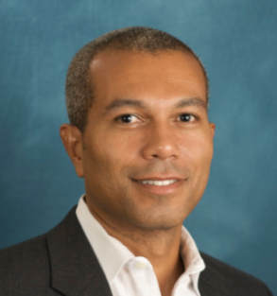
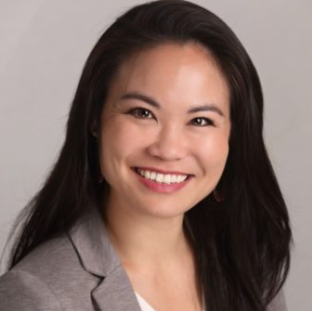
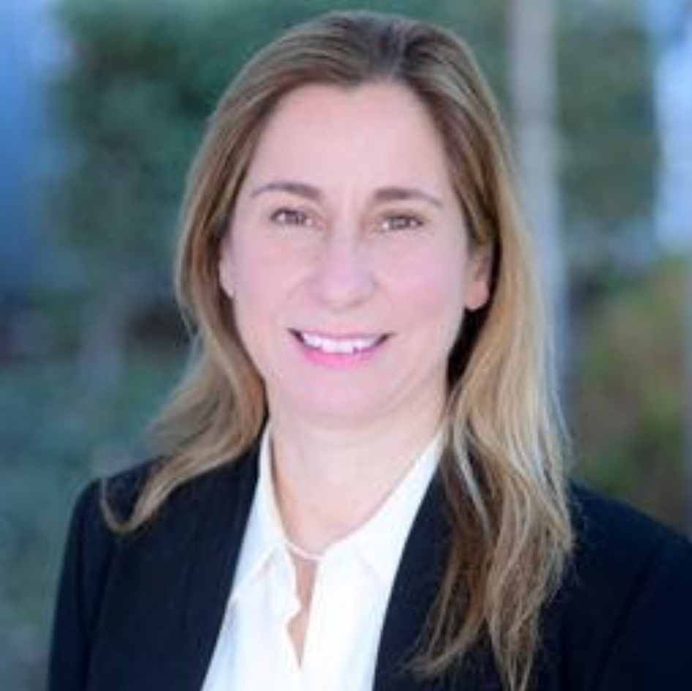
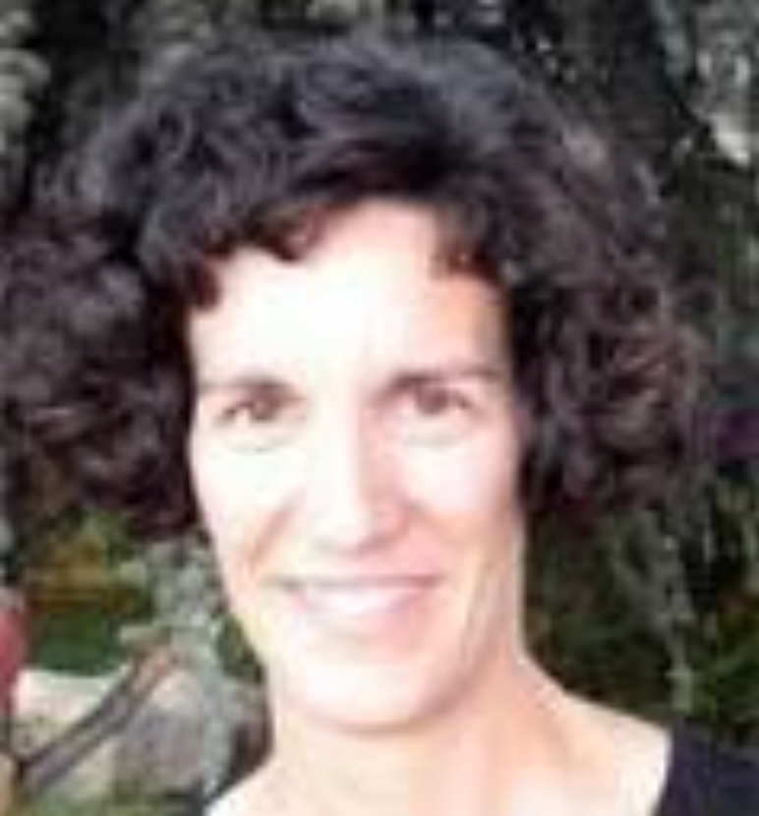
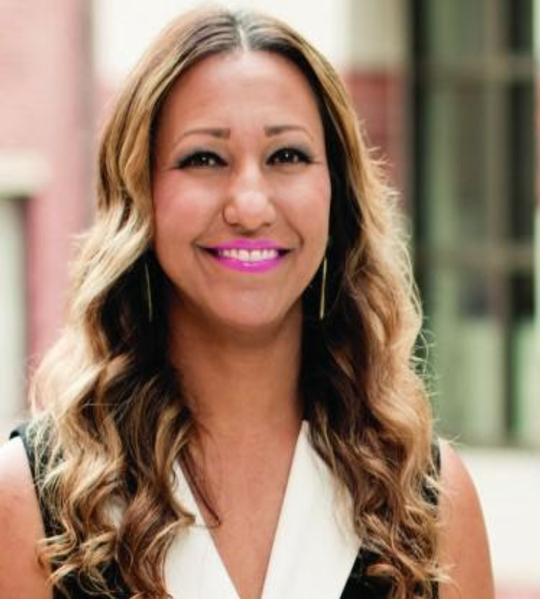
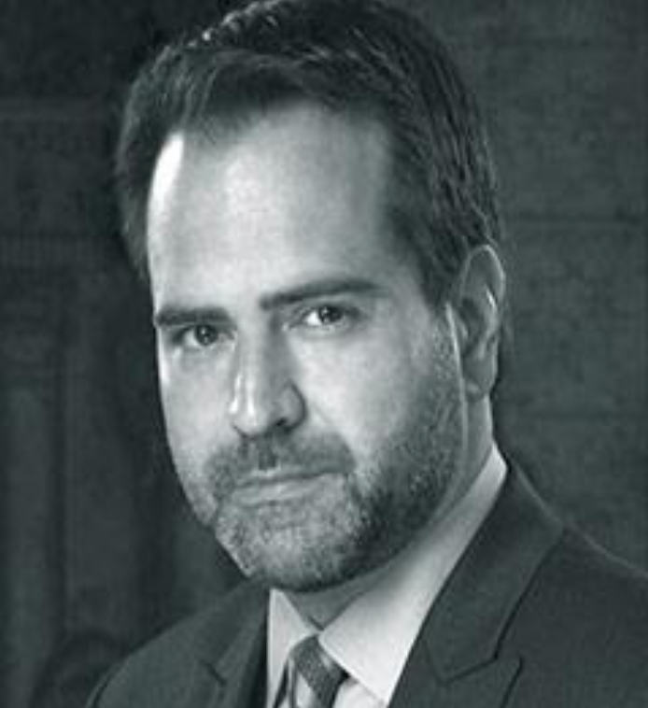
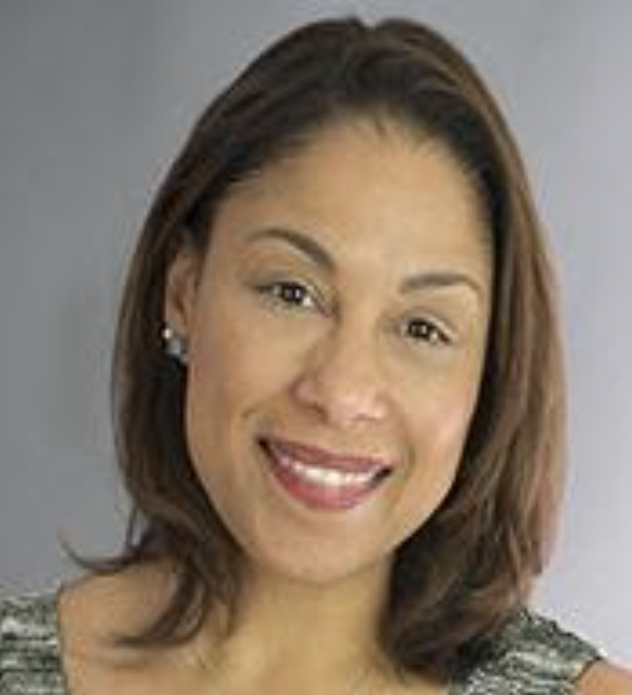
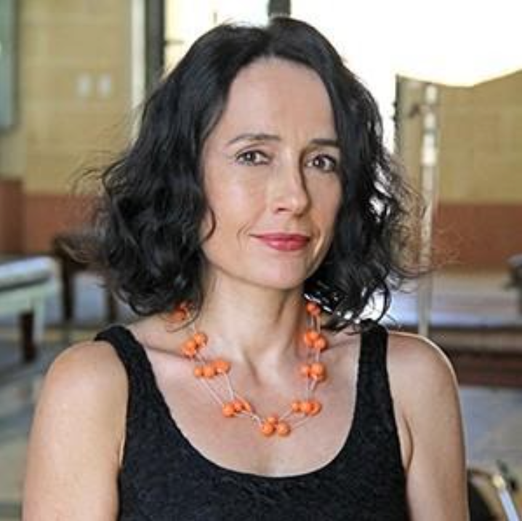
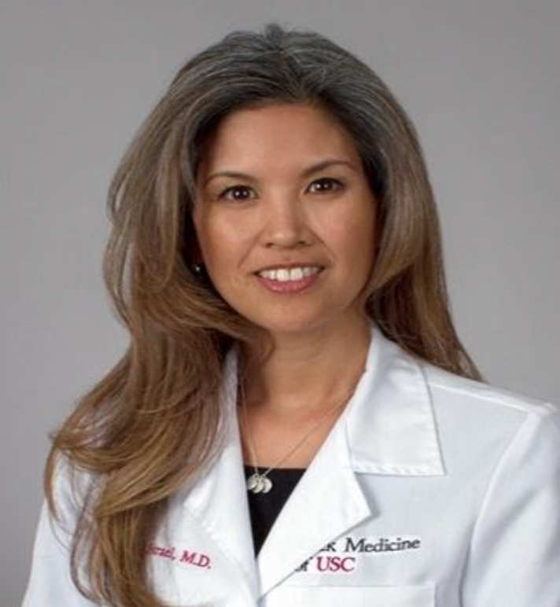
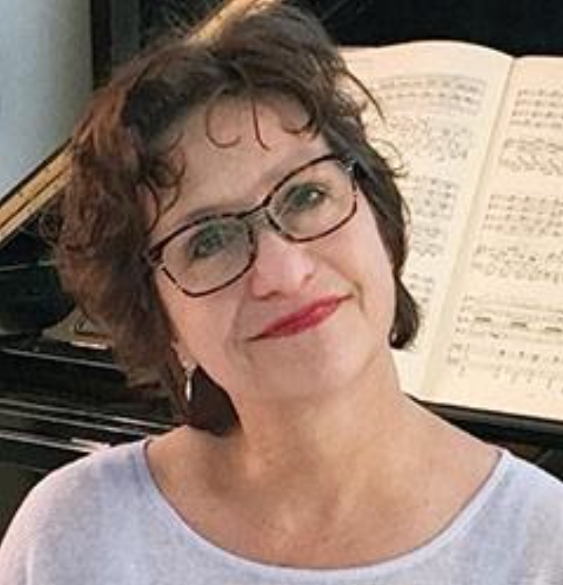
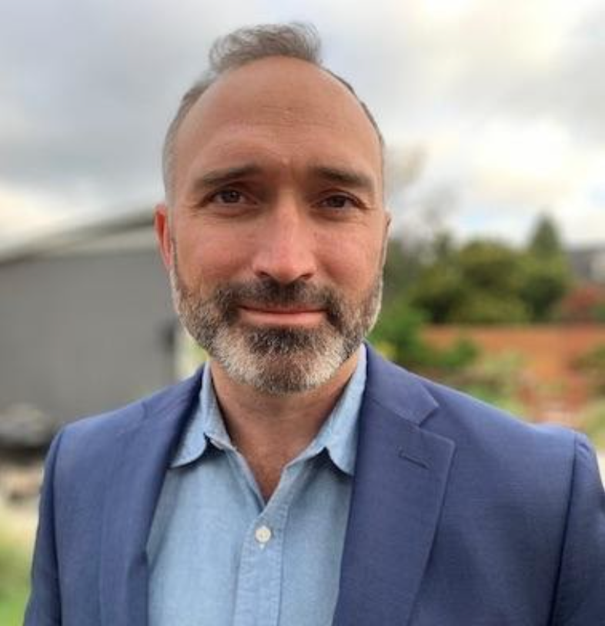
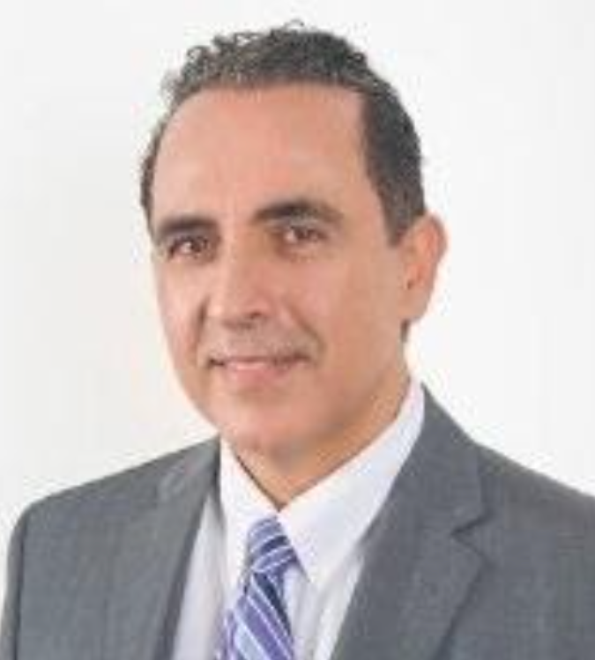
FR Committee Members
Devon Brooks (Co-Chair)
Suzanne Dworak-Peck
School of Social Work
Ashley Uyeshiro Simon (Co-Chair)
USC Chan Division of Occupational Science and Occupational Therapy
Rima Jubran
Keck School/CHLA
Kimberly Siegmund
Keck School/Population and Public Health Sciences
Shafiqa Ahmadi
Rossier School of Education
Nick Stoubis
Thornton School of Music
Ange-Marie Hancock Alfaro
Dornsife College/International Relations
Aniko Imre
Cinematic Arts
Jennifer J. Israel
Keck School/Obstetrics and Gynecology
Lucinda Carver
Thornton School of Music
Devin Griffiths
Dornsife College
Shahed Rowshan
Viterbi School

