Slide 1
A vision of
Diversity at usc
Office of Inclusion and Diversity

Slide 2
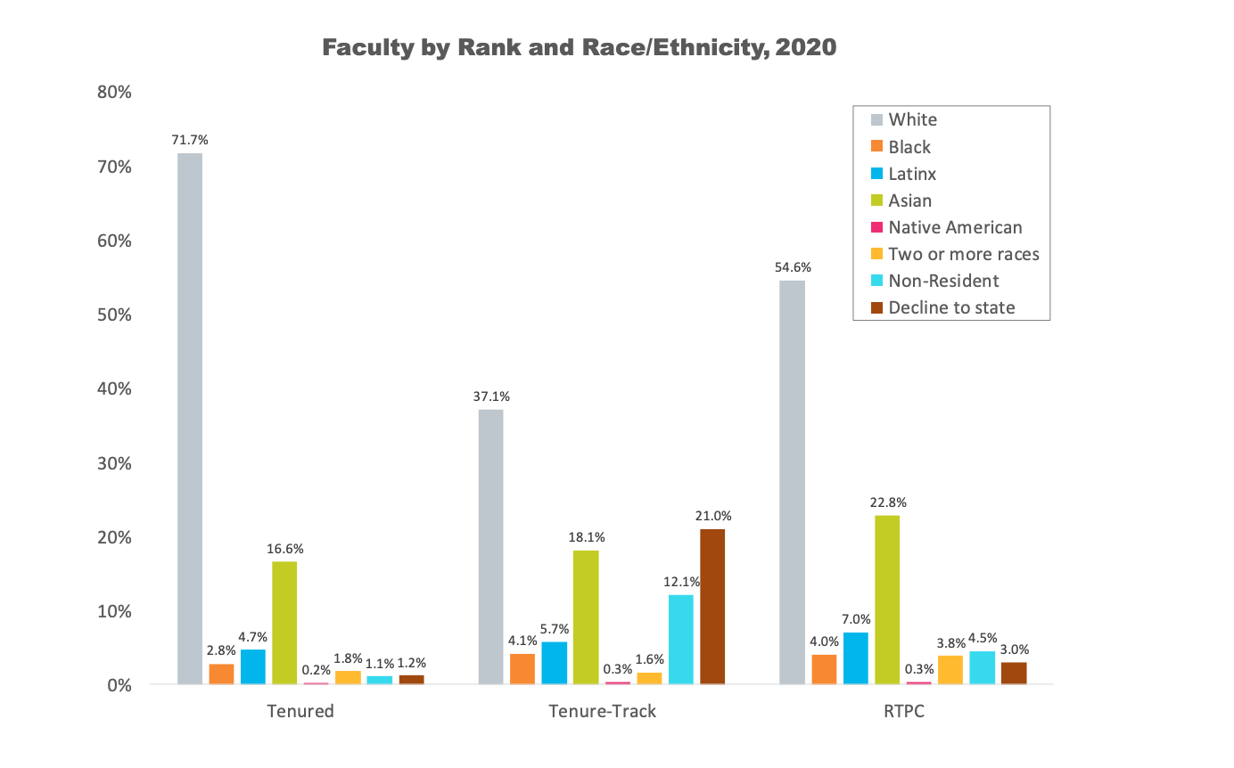
urgency
Faculty recruitment
Notes:
PRESENTER NOTE: FEEL FREE TO REMOVE AND ADAPT NEW SLIDES HERE AS THEY FIT YOUR AUDIENCE.

Slide 3
urgency
Faculty retention
Student wellbeing and retention
It is really disheartening to see the reality of attending this school. I’ve seen so many Black Trojans get bullied by the non BIPOC counterparts in our graduating class which has led them to consider transferring now. ..The fact that so many of my peers purposely go out of their way to bully and threaten Black students is disgusting and it really upsets me. Now I have to watch other Black Trojans leave due to the unsafe and intolerant environment my peers have created.
- Submission to @black_at_usc from the class of 2024
Notes:
Data from: https://nces.ed.gov/ipeds/datacenter/institutionprofile.aspx?unitId=123961
PRESENTER NOTE: FEEL FREE TO REMOVE AND ADAPT NEW SLIDES HERE AS THEY FIT YOUR AUDIENCE.

Slide 4
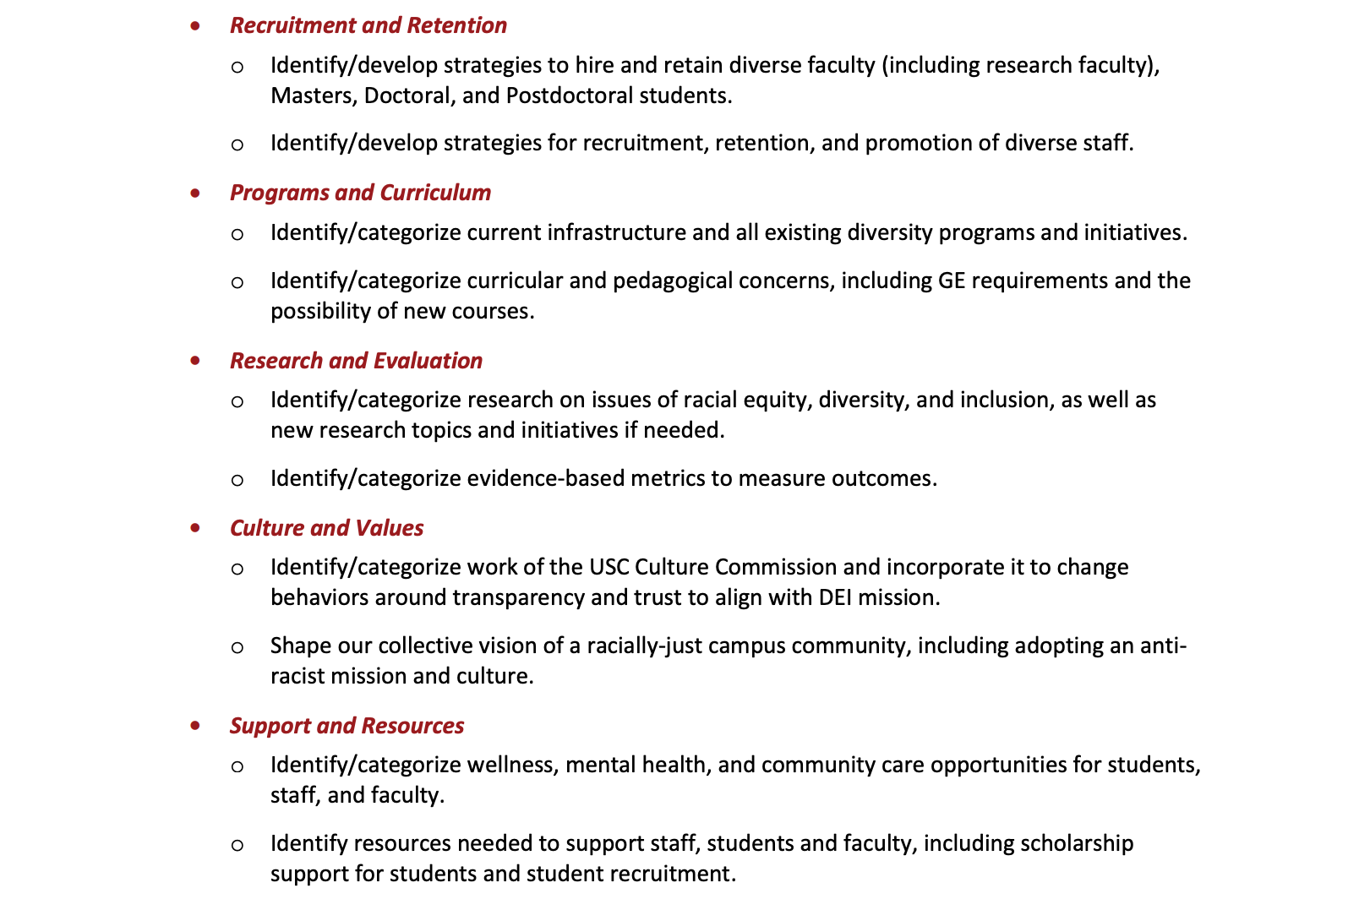
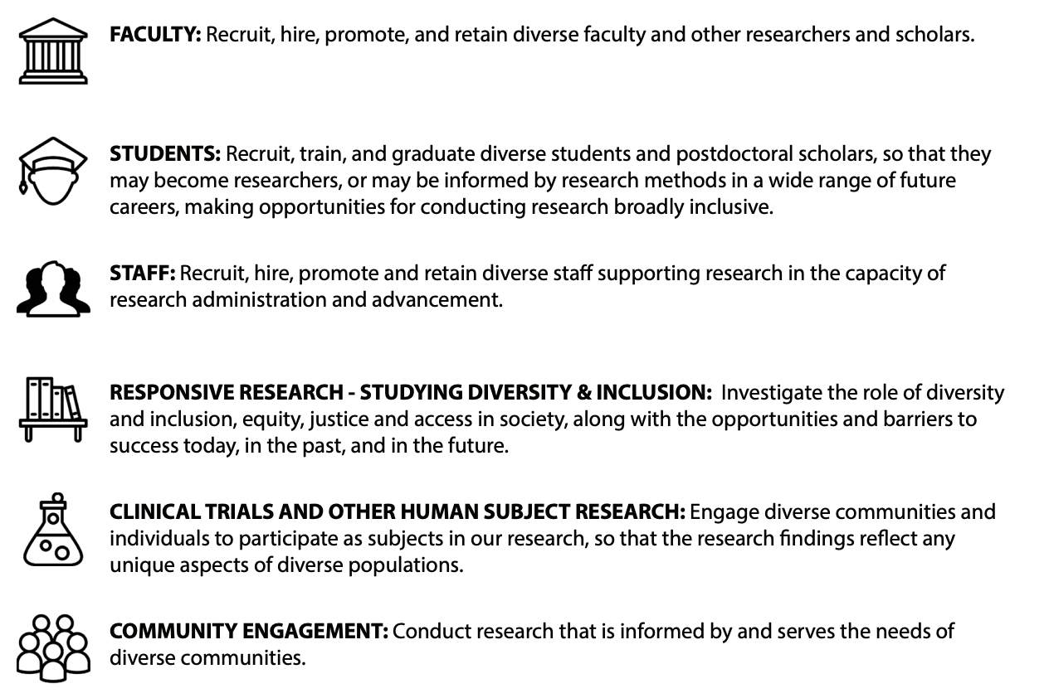
urgency
Faculty retention
Student wellbeing and retention
Institutional integrity
- USC Office of Research 2018 DEI Plan
2020 REDI Report
Notes:
PRESENTER NOTE: FEEL FREE TO REMOVE AND ADAPT NEW SLIDES HERE AS THEY FIT YOUR AUDIENCE.

Slide 5
What are your concerns?

Slide 6
A strategy in evolution: where we are today

Slide 7
goal
By aligning a comprehensive DEI strategy with the goals articulated by the community USC will become a place where all of its communities can succeed and fully contribute to our excellence as one the world’s leading universities.
How?
Innovating and expanding our DEI capacity
Synergizing our existing strengths
Harnessing new capacities to move forward existing and new collaboratively created DEI goals.

Slide 8
Short and mid-range strategies

Slide 9
Enhance our messaging
Diversity Equity and Inclusion are Necessary for Excellence.
Counters false narratives
Leverages existing identity & culture of excellence
Provides a consistent yet adaptable theme across audiences

Slide 10
Establish broad communications & support network- The diversity and inclusion council
With input from the Deans create a profile of college and school DEI leadership positions
Collaborate with non-academic VPs to map out corresponding positions
Organize as the University Diversity and Inclusion Council

Slide 11
Establish broad communications & support networks- The Student Diversity Network
Partner with Student Affairs to create a network of the university’s various diverse student groups
Notes:
In collaboration with Student Affairs, we began our network groups through conversations with the Cultural Assembly leaders. Our next steps is to include

Slide 12
Establish broad communications and support network-ergs
Employee Resource Groups
Employer-recognized workplace groups led by employees
Identity based ERGS build an inclusive environment
¡Several USC communities have already formed ERGS!
Black Staff and Faculty Caucus
USC Asian Pacific Islander Faculty and Staff Association

Slide 13
Benefits:
A nimble & broad DEI communications network
Easy and regular communication between members of our community and senior leadership
Studies show ERGs promote
A more engaging and fulfilling work
Greater productivity
Enhanced innovation
“ERGs bring many benefits to organizations. They identify and help develop internal leaders. They lead to higher retention rates. They educate employees — including senior leadership — through internal events, panels and more. They help companies recruit underrepresented individuals and develop a talent pipeline: According to a 2014 Survey conducted by Software Advice…52% of respondents between 25 and 34 reported they would be more likely to apply for a role at a company that had ERGs.”
Harvard Business Review

Slide 14
Building our internal capacity
Trojans For Excellence
Centralized DEI trainers
Composed of faculty and staff
Available upon request with customizable training modules
Yearly cohorts with stipends
Search Advocates
Embedded hiring support for hiring managers and search committees
Composed of faculty and staff
Available upon request
Yearly cohorts with stipends
Community Healing Corps
50 hours of advanced training and formal certification process
Centralized Restorative Community Builders
Composed of Faculty and Staff
Available upon request after case review and intake interviews
Annual Diversity Report
Existing Data from institutional research.
New data from the National Assessment of Collegiate Campus Climates survey

Slide 15
Long range strategic planning
Collect & review of existing DEI Plans and NACC data
Consul with and provide support to Divisional Leaders, Deans, Managers, and Directors
Determine a university DEI strategy
Collaboration is key
Individual plans
Hub and spoke or umbrella structure
Set OID Portfolio Areas
Address Opportunities Revealed by REDI

Slide 16
Oid portfolio areas
Faculty and Staff Success
Health Systems
Student Success
Notes:
Student Success:
Inclusive Learning Environment Provost Imitative
Graduation rates working group
Opportunity to further analyze data to address graduation needs for Native American, Latinx, Black, and LGBTQ+
Sub-data point: student debt amounts for these students
Student DEI Council:
Shared line of communication – amplify student voices and concerns
Solicit their feedback on our vision

Slide 17
Portfolio Areas
Faculty and Staff Success
Health Systems
Student Success
Notes:
Student Success:
Inclusive Learning Environment Provost Imitative
Graduation rates working group
Opportunity to further analyze data to address graduation needs for Native American, Latinx, Black, and LGBTQ+ (grad and undergraduate) students
Sub-data point: student debt amounts and sense of belonging for these student populations
Student DEI Council:
Shared line of communication – amplify student voices and concerns
Solicit their feedback on our vision
Collaborations with others:
REDI recommendations (with Provost Office)
CAB (Department of Public Safety) Recommendation Implementation (collaborating with Governmental Relations)
Student-Parent Resource Center (proposal stage) with GSG and Student Affairs
Native American Advisory Council (proposal stage) with CIPA Group
Minority Serving Institution Recruitment Event (proposal stage) with Annenberg, 15 other schools/programs, student affairs, and career center
NACC Survey – in collaboration with Race and Equity Center
Interfraternity Council (IF) and National Panhellenic Conference (NPC)

Slide 18
Address high yield aspects of the redi report
REDI’s Five Areas of DEI Activity
Recruitment & Retention
Programs & Curriculum
Research & Evaluation
Culture & Values
Support & Resources

Slide 19
How can we help you?

