Slide 1
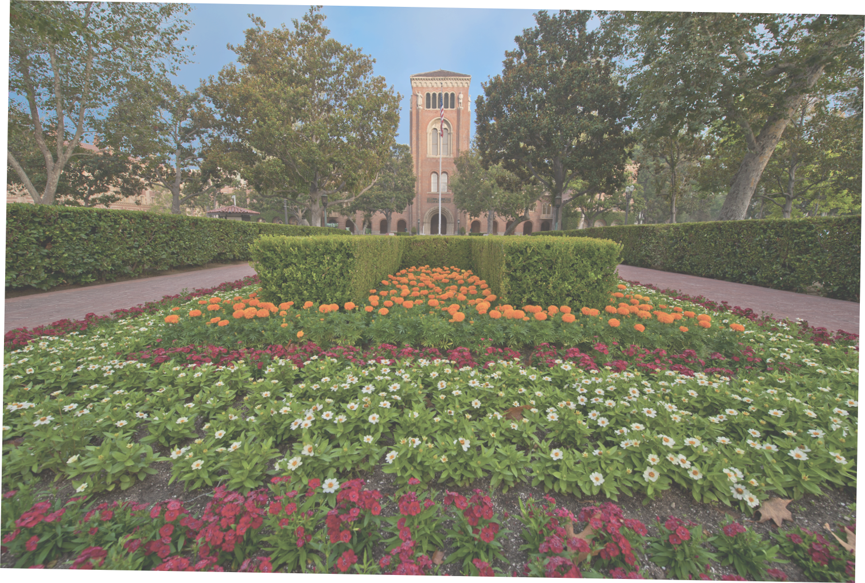
USC Student Mental Health Services
Past, Present and Potential
January 14, 2020

Slide 2
National Evolution of Student Health
From Counseling to Mental Health
Student’s mental health needs, acuity and expectations have dramatically increased over the past two decades.
College counseling systems have struggled to keep pace.
Universities across the Nation are trying to rapidly increase resources for student mental health.
Even those which have doubled their investment continue to refer students to the community for ongoing care.

Slide 3
Pre-2017
Student Counseling

Slide 4
USC Student Counseling
Pre-2017 at USC
Counseling Center: Outside/not integrated with medical system
Counseling Culture: Dealt with student problems not treated medical diagnoses
Minimal Clinical Care: Refer majority (80%) for care in community
~60% of students referred to community after initial consult
~25% received in-house stabilization before community referral
Understaffed: Therapist to student ratio 1:1750 (1:1000 Nat. avg.)
Integrated Into Student Life: Many activities unrelated to care

Slide 5
2017- 2019
USC Student Health
Keck Medicine of USC
Department of Psychiatry
Student Counseling & Mental Health

Slide 6
Integration of Student Health into Keck Medicine
Department of Psychiatry
New Administrative Structure: Part of Keck Med. & KSOM
New Clinical Oversight: Credentialing, peer review, conduct
New Policies & Procedures: Integrated EMR & administration
New Standards for Productivity: Assigned clinical requirements
Expanded Staffing: Increased number of FTE by 50%
Clinician Ratio: Increased therapist to student ratio to 1:1000
Moving Target: National average moved to 1:500

Slide 7
Integration of Student Health into Keck Medicine
Department of Psychiatry
Reduced Referral Rate: Refer ~40% to community after consult
Varied Backgrounds: Qualified non-student health perspective
Specialized Programs: e.g. Eating disorders, behavioral health
Continued Many Practices: Initial phone screens and referral
New University Administration: Empowering positive change
Renewed Opportunity for Improvement: Short & long term

Slide 8
2020
Keck Medicine of USC
Student Health
Department of Psychiatry
Student Mental Health Services

Slide 9
USC Student Health, Keck Medicine of USC
The Department of Psychiatry, KSOM
Short-Term Interventions: Changes underway presently
Improve First Contact: Phone screens to in-person intakes Jan ‘20
Live After-hours Operators: More accommodating atmosphere
Extended Hours: Adding evenings and weekends (overloads)
Extended Days: Added holiday and exam time coverage
Expanded Locations: Satellite offices, in 4 schools and athletics
Recruited Volunteers: Crisis team from 4 schools and 8 depts.

Slide 10
USC Student Health, Keck Medicine of USC
The Department of Psychiatry, KSOM
Long-Term Strategies: Actions for sustained improvement
Extend Hours Permanently: Open Evenings and Weekends
Extend Locations: Academic, Cultural & Residential satellites
Expanded Staffing: ~18 Therapists & 2 Psychiatrists (1:680*)
Substance Use Disorders Strategy: Active use = major risk
Prevention & Education: Campaign to reduce use
Enforcement: Address high-risk communities (e.g. Greek)
Develop Partnerships: Active substance use disorders

Slide 11
USC Student Health, Keck Medicine of USC
The Department of Psychiatry, KSOM

Slide 12
Department of Psychiatry Student Practice
Current State
Opened: November 19, 2019 with 6 clinicians
Growing: Adding 12 more clinicians by July 2020
Access: Addresses major gap in mental health care availability
Insurance: Aetna Stud. Health, USC PPO/EPO, limited others
Scope: Treat ~ half of the students needing long-term care
Outpatient Only: No partial hospital, drug detox or rehab

Slide 13
Department of Psychiatry Student Practice
Long-Term Strategies
Insurance Gap: Requires University underwriting
Limitations: Space and resources set scope
Opportunities for Growth: Expand hours 50% in current model
Evenings & Weekends: Nine more clinicians
Resources: Additional underwriting required
Additional Populations: Requires broader approach

Slide 14
Opportunities and Challenges
Faculty Recruitment
National Shortage of Psychiatrists
Competitive Landscape for Mental Health Providers
Determine Scope of Change
Set Priorities
Determine Resource Availability

Slide 15
Thank You

Slide 16
Integration of Student Health into Keck Medicine
Department of Psychiatry
Outreach & Prevention Programs
“Let’s Talk”: Conversations with counselors
“Thriving Thursdays”: Drop-in activities
Embedded Counselors: In academic departments
Community Strategies: “BeThe1To” Suicide Prevention
Population Surveillance: Healthy Minds survey drives decisions
Comprehensive Prevention: Following Jed Foundation’s National guidelines for population health best practices

