Slide 1
Ilene Rosenstein, Ph.D.
Lyndsey Christoffersen, Ph.D
Campus Wellness & Education
Skip Rizzo, Ph.D.
Kelly Christoffersen
Institute for Creative Technologies

Slide 2
Meet Ari
Ask Ari is USC’s interactive app providing custom-tailored, evidence-based information, resources and referrals that promote whole-person wellbeing

Slide 3
Meet Ari
Topics sleep, stress, mood, healthy communication, thriving, life skills/organization, cognitive distortions, relationships, and career
Partnership: Campus Wellbeing & Education, Institute for Creative Technology, and the Office of the Provost
Conceived and created at USC for USC
Started in 2017

Slide 4
Why Ask Ari
The Problem:
In USC’s hyper-competitive environment, students may feel uncomfortable seeking out professional help for issues surrounding their wellbeing. Students want to improve their lives and engage with their community but need the knowledge, skills, and resources to do so.
The Solution:
Ari engages in dialogue with the user and, based on their responses, offers:
Tools and prompts for self-reflection and self-awareness
Relevant, research-based information for further exploration
Referrals to appropriate local, online or campus resources

Slide 5
Why Ask Ari
Connect to self
Self-reflection to better understand their issues and concerns
Increase easy access to research-supported educational information on well-being (Schultz & Nakamoto, 2013)
Connect to community
Those with mental illness may be reluctant to go to help; artificial intelligence technologies, like Ask Ari, serve as a gateway (Lucas et al., 2014, 2017; Rizzo & Koenig, 2017)
Faculty and staff can refer to Ask Ari gateway
Connect to USC
Better communicate USC resources
Communicate when to use USC resources
Technology based on years of peer reviewed research at ICT

Slide 6
Key Benefits
Privacy – no judgment
Convenience – available anytime, anywhere
Access to a vast knowledge base – evidence-based information, as well as apt referrals
More than information:
Intelligence – Ari is more like a concierge than an assistant, offering recommendations for further exploration, not just a list of search results

Slide 7
Major Findings
93%
89%
More knowledgeable about how to take care of myself
The information provided was helpful to me

Slide 8
Average Usage Overview
Time on Ask Ari: 15 Minutes
Utilization: Twice
7 Questions, 3 Topics
Top 5 Questions Asked:
1. What can I do to focus? I’m having a hard time focusing.
2. How do I deal with academic/exam stress?
3.What are some sleep guidelines?
4. What are some tips for dealing with stress?
5. How do I get to bed on time?
Notes:
Average time: 15 minutes
Average usage: twice
Pageviews:
Unique users:
Questions ask
Areas of interest

Slide 9
DEMO

Slide 10
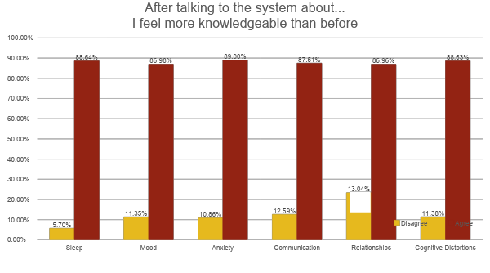
Major Findings
13.04%

Slide 11
I liked that it was honest and provided feedback on general statements such as "break ups". Not many automatic systems can relate to that and detect that and further provide feedback on the topic.
It was helpful to ask someone questions from the comfort of my bed. It is easier to talk to a virtual human under certain circumstances.
It was informative and interactive! I was impressed by the knowledge database. I also liked the range of topics and all of the referrals it made.

Slide 12
Features: Technology
Interface Refinements
• Standards Compliant :: ADA Section 508, W3C Validated
Responsive Design :: Mobile, Tablet, Laptop, Desktop
Dynamic Menu :: Follows Conversation Topic
Guided Overview:: Interface Usage
Recent Development
• Change Sets :: 551 Revisions Committed (~6/Week)
• Code & Markup :: 100,000 lines edits (~135/Day)

Slide 13
Features: Technology
Added Features
Multimodal Input :: Menu, Prompt, Text, Voice
Multimedia Output :: Text, Voice, Animation
Message Controls :: Single Mode, Fast Forward
Language Controls :: 32 Languages; Input & Output
Text to Speech :: Runtime Generated; Configurable
Feedback Dialog :: Documents User Expectations

