Slide 1
Keck Medicine Professionalism Program
A Cornerstone of our Culture of Safety Initiative
John L Brodhead, MD
Associate Professor of Internal Medicine, Keck School of Medicine
Chief Of Staff
Keck Hospital of USC and USC Norris Cancer Hospital
Tammy Capretta, RN MPH
Chief Integration and Risk Officer, Keck Medicine of USC
Healthcare Compliance Officer
February 21, 2018

Slide 2
Keck Medicine Professionalism Program
2009
2014
2015
2016
Hospital Acquisitions
Assessment
Design
Launch
2

Slide 3
Vanderbilt Center for Patient and Professional Advocacy
  The Vanderbilt Program facilitates the delivery of patient and coworker complaints through a peer to peer delivery system and offers the professional the opportunity to self-correct
  A tiered, graduated coaching model provides a progressive pathway to allow the professional to correct a high complaint pattern through the following:
    Peer to peer coaching
    Joint action planning
    Referral to peer review
  Vanderbilt’s published literature illustrates the positive impact of this program over the costs of professional liability costs
  Academic and Health System Members include: Stanford, the UC System, Yale, Emory, John’s Hopkins, University of Pennsylvania and Loyola
3

Slide 4
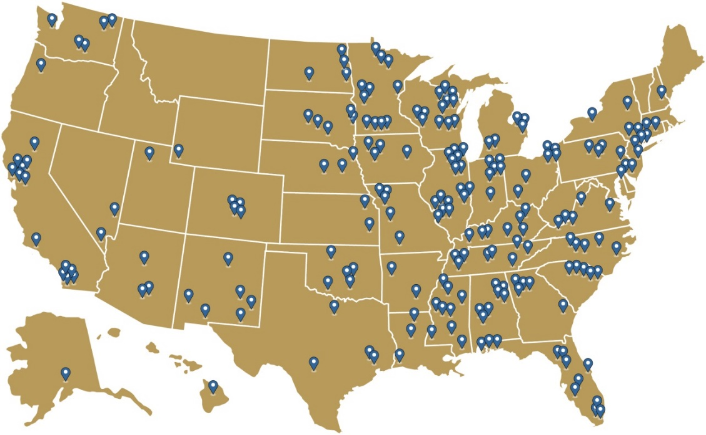

Vanderbilt CPPA Partner Sites
Academic Medical Center
PARS® Partners
Cornell University
Columbia University
Emory University
Johns Hopkins University
Johns Hopkins Bayview MC
Loyola University
Lucille Packard Children’s Hospital
Saint Louis University
Stanford University
UCLA
UC San Francisco
UC Davis
UC Irvine
UC San Diego
UC Riverside
University of Illinois, Chicago
University of Iowa
University of Mississippi
University of North Carolina
University of Pennsylvania
University of Southern California
University of Toledo
Vanderbilt University
Wake Forest University
System, Regional and Medical Practice PARS® Partners
Charlotte Ear, Eyes, Nose, Throat Assoc.
Edward Hospital System
Elmhurst Memorial Health Care
Geisinger Health System
Hospital Sisters Health System
Mercy STL
NorthShore University Health System
OrthoCarolina
Palo Alto Medical Foundation
Queen’s Medical Center
Rush Medical Center
Sanford Health
NY Presbyterian

Slide 5
5

Slide 6
Design and Launch of Keck Medicine Professionalism Program
Driving Premise: Professionals Self-Correct
Key Elements:
Statement of Professional Standards
Peer-to-Peer Coaching
Commitment to an intervention model
Coaching Themes:
Disrespectful/Unkind Communication
Failure to Comply with Policy and Procedures that might impact the Safety of the Environment
Failure to be Accessible
National Experience (~18,000 physicians)
76% of identified providers self-correct;
17% escalate to interventions; and
7% Depart
Pichert et al., ABIM Foundation Professionalism Prize, Journal on Quality and Patient Safety, 2014.
6

Slide 7
Keck Medicine Peer Coaching Team (PCT)
Chair - Steven L. Giannotta, MD
Co-Chairs - John Brodhead, MD and Kiran K. Dhanireddy, MD
Physician Coaches
Tay, Candice
Liu, John
Robinson, Jehni
Cunningham, Mark
Reder, Lindsay
Amezcua, Liliana
Dunn, Matt
Matthews, Ray
Carey, Joseph
Nelson, Maria
Baron, David
Mahli, Harshawn
Jennelle, Richard
Kauffman, Wayne
Israel, Jennifer
Oakes, Dan
Lam, Linda
Chang, Eric
Siegel, Steven
Oghalai, John
Muderspach, Laila
Mosqueda, Laura
Grant, Edward
Chiu Helena
Ahronowitz, Iris
Buchanan, Thomas
Hallows, Kenneth
Hammond, Terese
Karp, Michael
Kumar, Santhi
Lee, Sang
Patel, Vivek
Sattler, Fred
Song, Jonathan
Spicer, Darcy
Strum, Earl
Urata, Mark
Zhang-Nunes, Sandy
Baker, Craig
Botello, Tim
Clavijo, Leonardo
Dancz, Christina
DeClerck, Brittney
Fuchs, Gerhard
Grazette, Luanda
Hall, Stephanie
Homeier, Diana
Inaba Kenji
Kokot, Niels
LoPresti, Jonathan
Naritoku, Wesley
Opas, Lawrence
Rajamohan, Anandh
Rowe, Vincent
Salazar, Adler
Shavelle, David
Shoemaker, Erica
Stevanvic, Milan
Taira, Taku
Takahashi, Stefani
Varner, Chelsia
Etcheverry, Josette
Berber, Kevin
Zada, Gabriel
SG
7
Notes:
7

Slide 8

Keck Medicine Professionalism Program: Results to Date
4-Year Journey
69 Peer Coaches trained
32 Program Directors Trained for Resident Expansion
84 of ~900 Attending Physicians Addressed by Peer Coaches
Exploring Expansion into Nursing
Level 1: 18 Providers identified
Level 2: 5 Providers identified
Level 3: 3 Providers identified
Departed: 2 Providers
As of Feb. 2018
8

Slide 9
Vanderbilt Center for Patient and Professional Advocacy: Criteria for Cultural Change
8
9

Slide 10
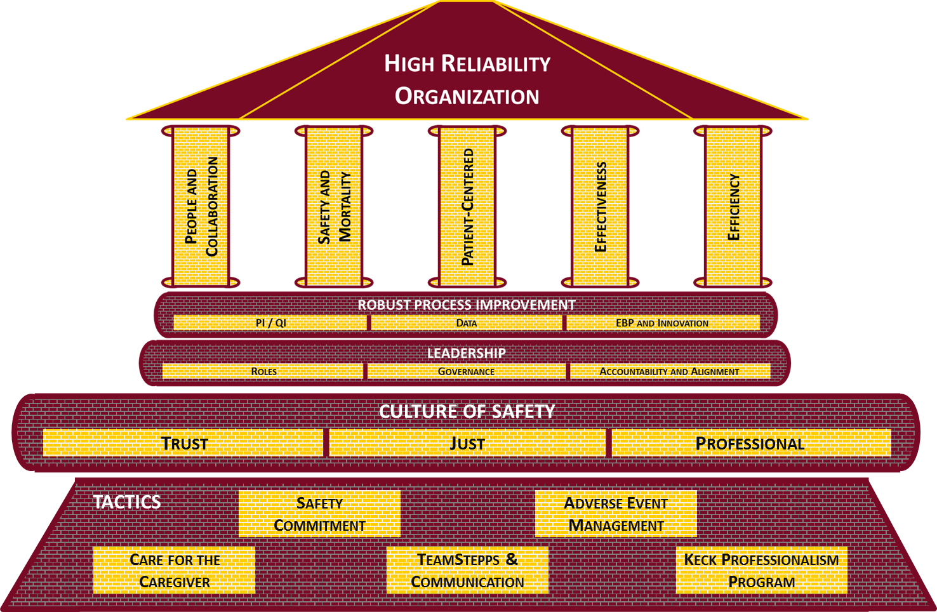
Culture of Safety Initiative
Foundational Tactics
of the
Culture of Safety
Initiative
Safety Commitment
TeamSTEPPS/ Communication
Care for the Caregiver
Adverse Event Management
Keck Professionalism Program
10

